Slide 1
The future of technology, law enforcement, and justice
ICJIA
Feburary, 2013

Slide 2
Predictions
The future of technology

Slide 3
Predictions
The telephone has too many shortcomings to be seriously considered as a means of communications
Western Union Executive, 1876

Slide 4
Predictions
Heavier-than-air flying machines are not possible
Lord Kelvin, 1895

Slide 5
Predictions
Airplanes have no military value
Professor Marshal Foch, 1912

Slide 6
Predictions
I think there is a world market for maybe five computers.
IBM Chairman Thomas Watson, 1943

Slide 7
Predictions
Computers in the future may weigh no more than 1.5 tons.
Popular Mechanics, 1949

Slide 8
Predictions
There’s no reason for individuals to have computers in their home.
Ken Olson, DEC CEO, 1977

Slide 9
Predictions
640,000 bytes should be enough for anybody
Bill Gates, 1981

Slide 10
Predictions
The Internet will catastrophically collapse in 1996
Robert Metcalfe (inventor of ethernet)

Slide 11
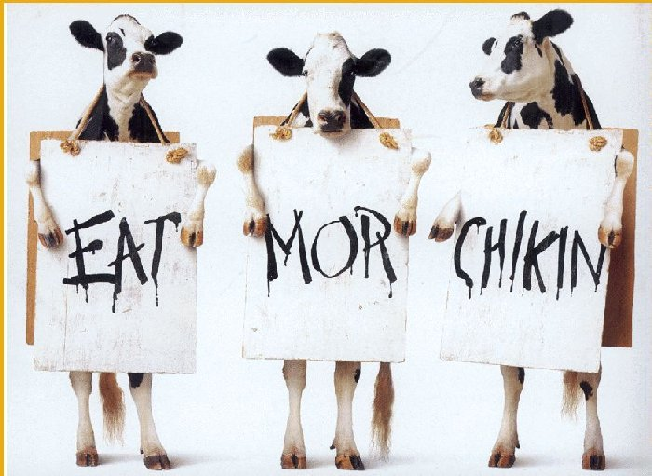

Slide 12
2020

Slide 13
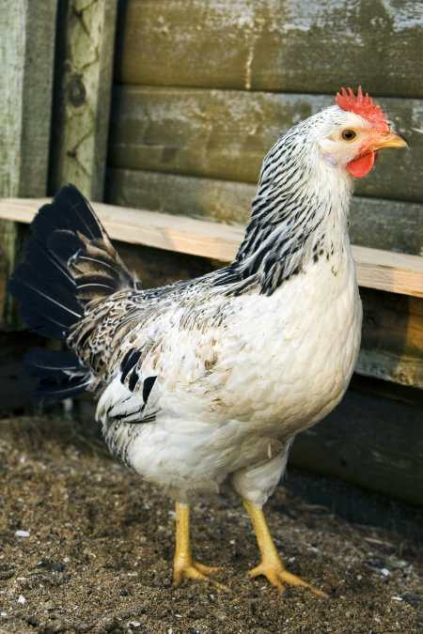

or
Operational innovation
Technology
innovation

Slide 14


Slide 15
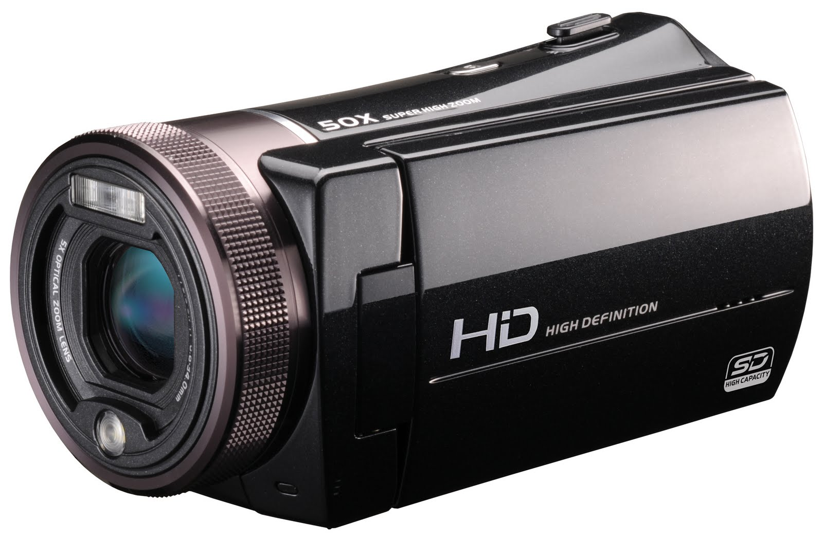

Slide 16
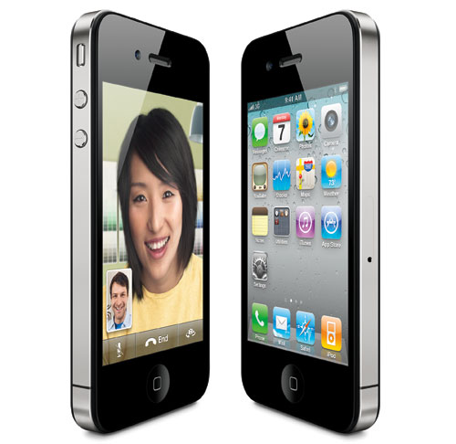
Phone
Camera
Video recorder
Video player
Search engine
GPS Navigation
App Provider
E-mail
Phone book
Calendar
Smarter phone

Slide 17


Slide 18

Justice Predictive Analytics

